Slide 1

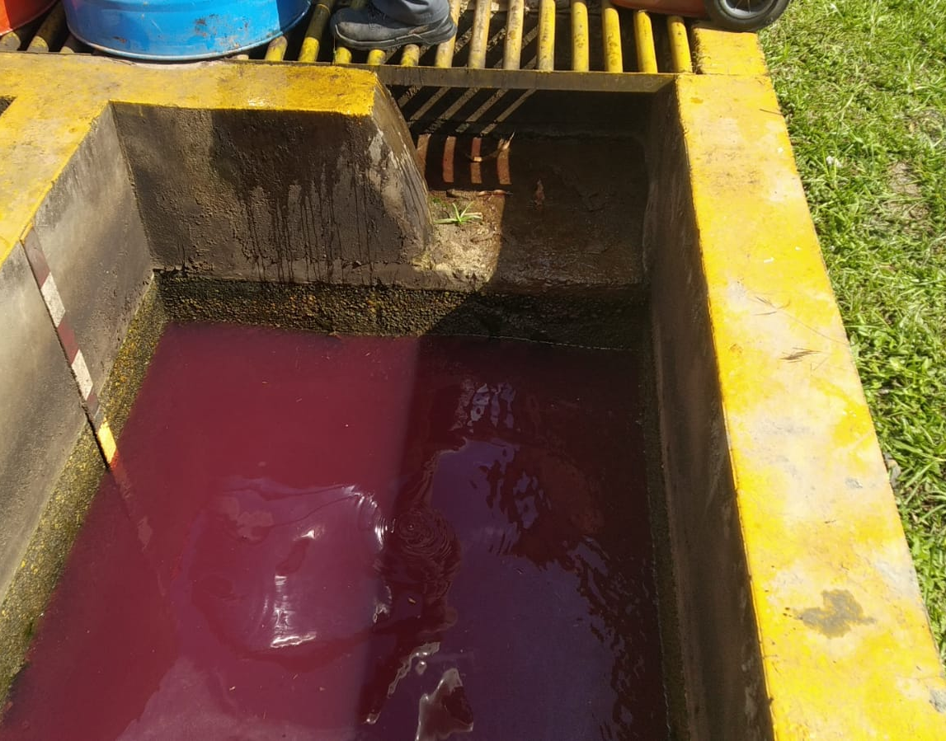
Investigation Report
Penetrant Chemical Case that carry over to oil separator
Schlumberger Duri

Slide 2
Where ??
What ??
Penetrant chemical case that carry over to oil separator
Washbay Completion

Slide 3
Who ??
When ??
Friday, 10 March 2023 at 13.00 pm
OCTG team PT. Inspektindo Sinergi Persada

Slide 4
Why ??
Inadequate Draininage facility for waste wate
Natural Factor (high intensity rainfall)
How ??
No | Conducting Liquid Penetrant Inspection on march, 2023 | Qty
1 | 02 March 2023 | 2
2 | 04 March 2023 | 1
3 | 05 March 2023 | 1
4 | 06 March 2023 | 6
5 | 10 March 2023 | 6

Slide 5
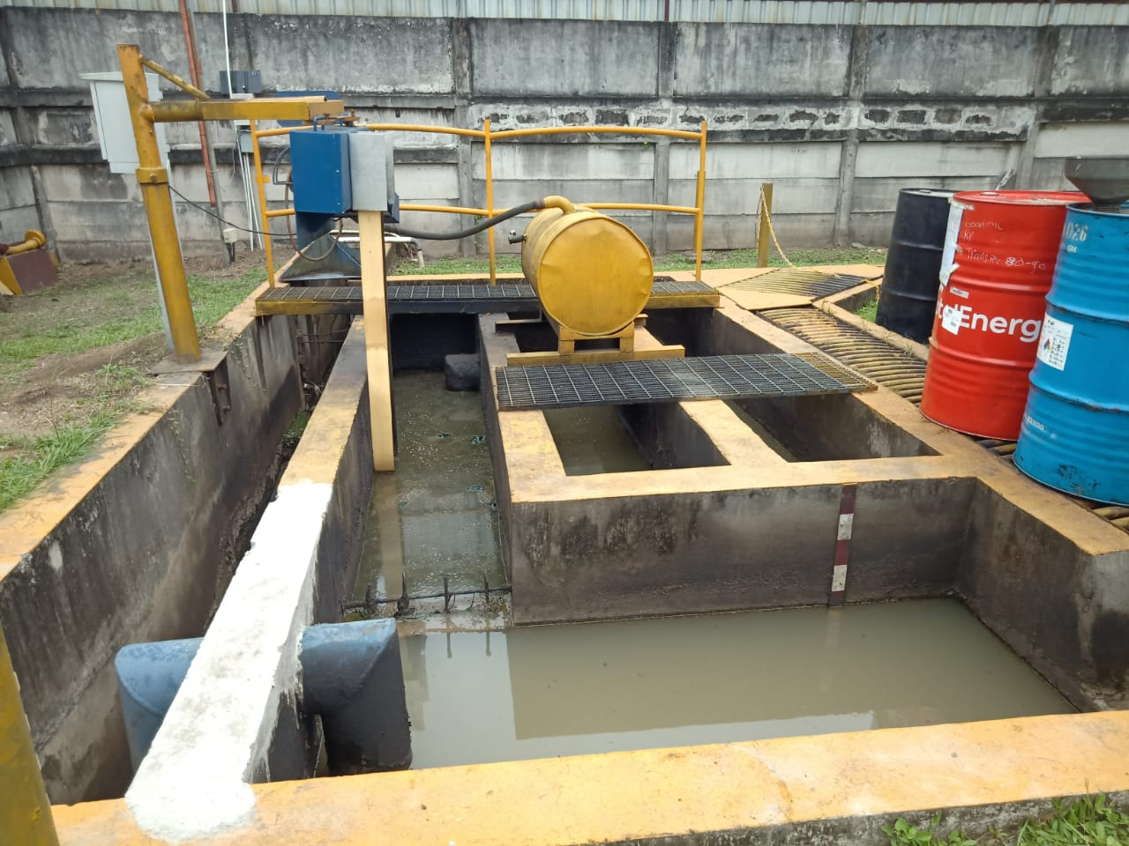
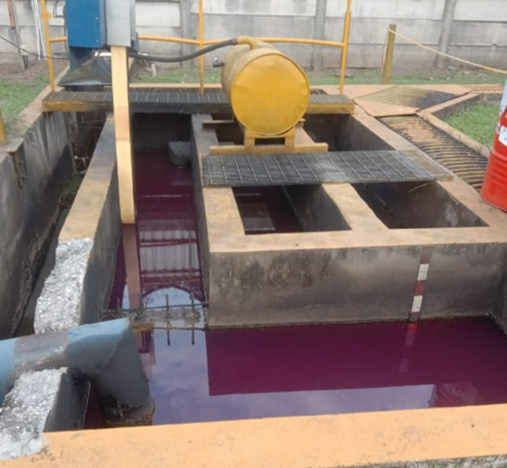
How ??
On march 3,4,5 high intensity rainfall
On march 10, Waste water in oil separator has turned red
Photograpic Evidence :
Before
After

Slide 6
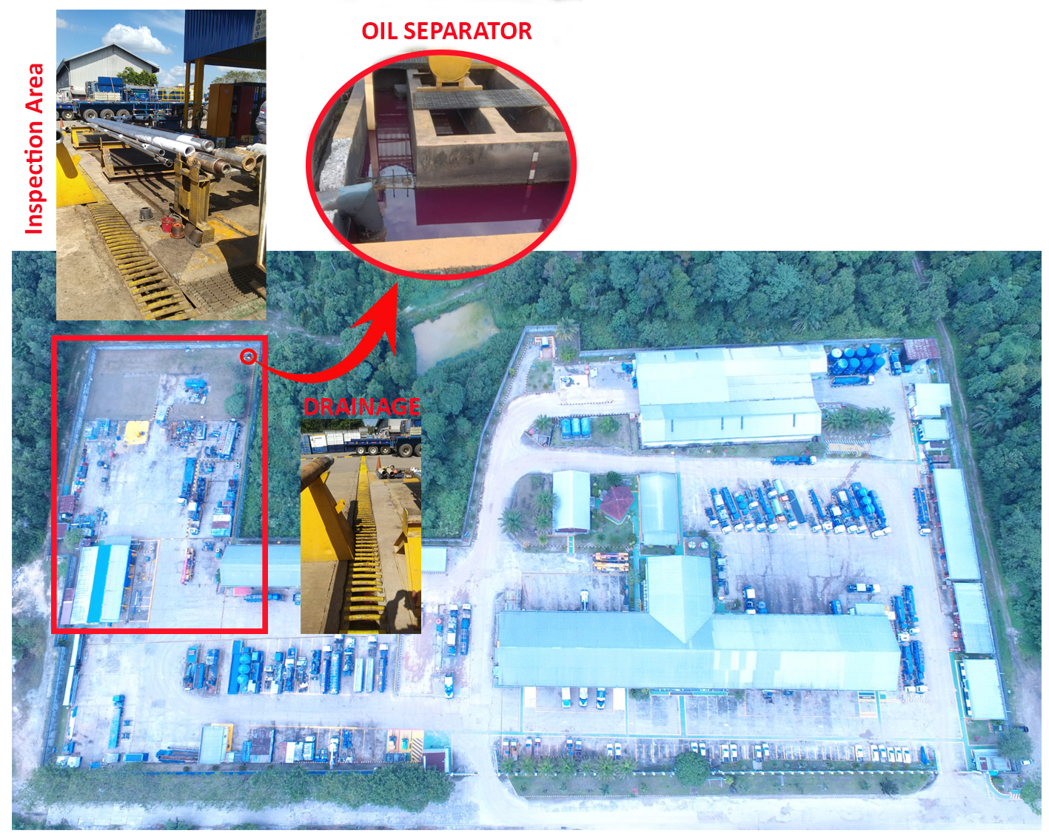
Position
Evidence

Slide 7
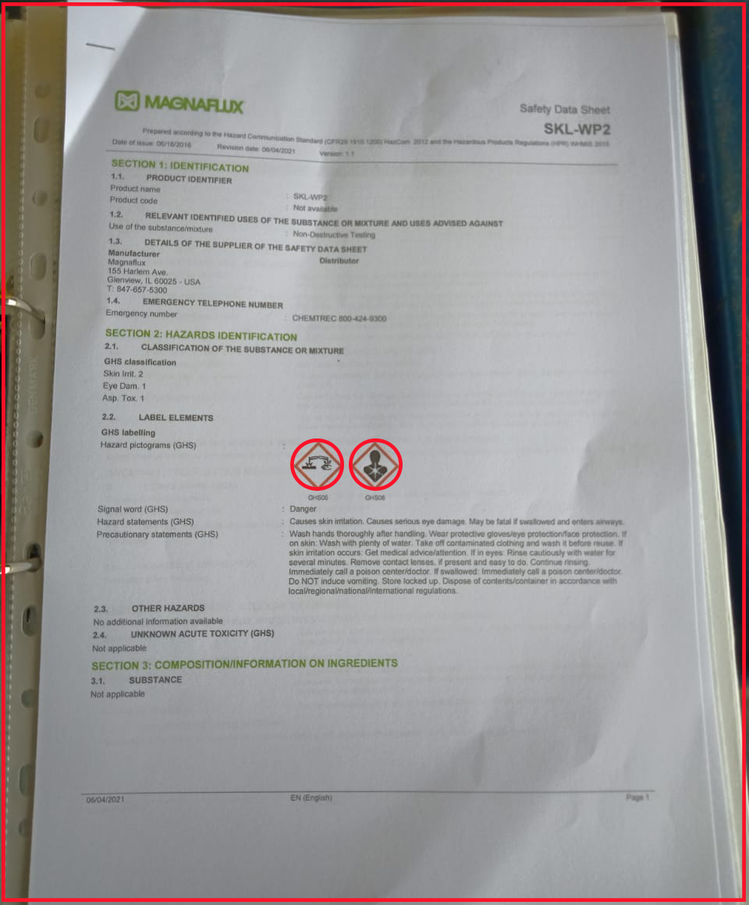

Written evidence
Corrosive
Mutagenik
Karsinogenik
Not found this symbol on MSDS
X
Harmful to the environmental

Slide 8
Immediate Cause
NA
Unsafe Condition
Natural Factor (high intensity rainfall)

Slide 9
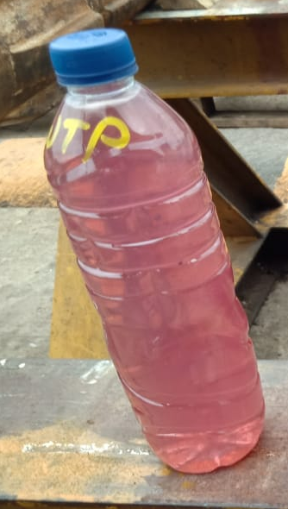
Correction
Laboratory tests using third party services
Sampling estimation
27-31 March, 2023
Noted
Report results will come out after 20 days of sampling

Slide 10
Corrective Action
Provide portable waste container to collect penetrant waste water from washing activity.
To inform the SLB facility personel by WA Group whenever penetrant application perform by ISP

Slide 11
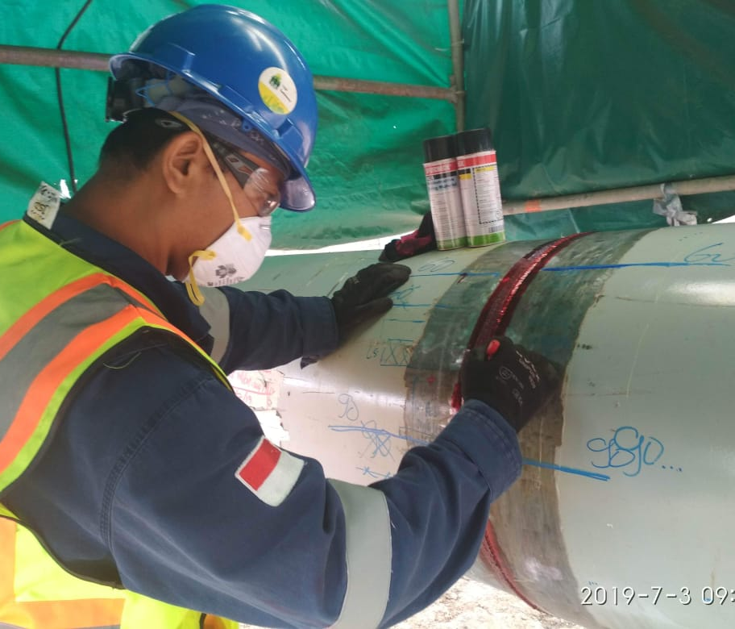
THANK YOU!
Oki Wiranata
Phone:
+62 852-6470-4288
Email:
okki.Wiranata@inspektindo.com

